Slide 1

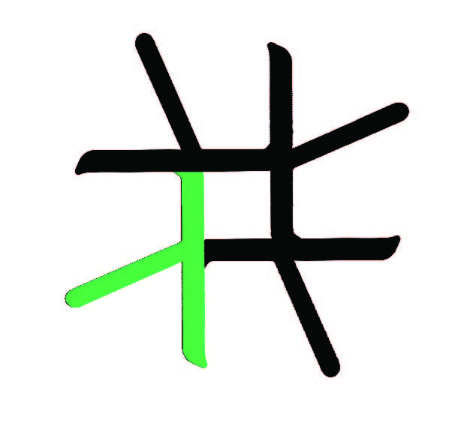
Eden
Parallel Functional Programming with Haskell
Rita Loogen
Philipps-Universität Marburg, Germany
Joint work with
Yolanda Ortega Mallén, Ricardo Peña
Alberto de la Encina, Mercedes Hildalgo Herrero, Christóbal Pareja,
Fernando Rubio, Lidia Sánchez-Gil, Clara Segura, Pablo Roldan Gomez
(Universidad Complutense de Madrid)
Jost Berthold, Silvia Breitinger, Mischa Dieterle, Thomas Horstmeyer,
Ulrike Klusik, Oleg Lobachev, Bernhard Pickenbrock, Steffen Priebe, Björn Struckmeier
(Philipps-Universität Marburg)
CEFP Budapest 2011

Slide 2


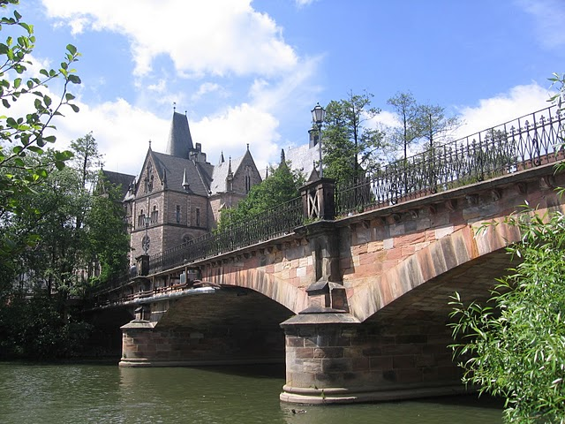
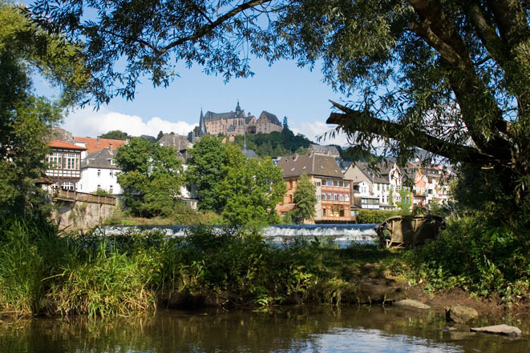
Marburg /Lahn

Slide 3
Overview
Lectures I & II (Thursday)
  Motivation
  Basic Constructs
  Case Study: Mergesort
  Eden TV –
  The Eden Trace Viewer
  Reducing communication costs
  Parallel map implementations
  Explicit Channel Management
  The Remote Data Concept
  Algorithmic Skeletons
    Nested Workpools
    Divide and Conquer
Lecture III: Lab Session
(Friday Morning)
Lecture IV: Implementation
  Layered Structure
  Primitive Operations
  The Eden Module
    The Trans class
    The PA monad
    Process Handling
    Remote Data

Slide 4
Materials
Materials
Lecture Notes
Slides
Example Programs (Case studies)
Exercises
are provided via the Eden web page
www.informatik.uni-marburg.de/~eden
Navigate to CEFP!

Slide 5
Motivation

Slide 6
Our Goal
Parallel programming at a high level of abstraction
inherent parallelism
functional language
(e.g. Haskell)
=> concise programs
=> high programming efficiency
automatic parallelisation
or annotations

Slide 7
Our Approach
Parallel programming at a high level of abstraction
+
parallelism control
  explicit processes
  implicit communication
  distributed memory
  …
functional language
(e.g. Haskell)
=> concise programs
=> high programming efficiency
λ
λ
λ
λ
Eden = Haskell + Parallelism
www.informatik.uni-marburg.de/~eden

Slide 8
Basic Constructs

Slide 9
Eden
parallel
programming
at a high level of
abstraction
= Haskell + Coordination
  process definition
  process instantiation
process :: (Trans a, Trans b) => (a -> b) -> Process a b
gridProcess = process (\ (fromLeft,fromTop) ->
let ... in (toRight, toBottom))
process outputs
computed by
concurrent threads,
lists sent as streams
( # ) :: (Trans a, Trans b) => Process a b -> a -> b
(outEast, outSouth) = gridProcess # (inWest,inNorth)

Slide 10
Derived operators and functions
Parallel function application
  Often, process abstraction and instantiation are used in the following combination
Eager process creation
  Eager creation of a series of processes
($#) :: (Trans a, Trans b) => (a -> b) -> a -> b
f $# x = process f # x -- ($#) = (#) . process
spawn :: (Trans a, Trans b) =>
[Process a b] -> [a] -> [b]
spawn = zipWith (#) -- ignoring demand control
spawnF :: (Trans a, Trans b) =>
[a -> b] -> [a] -> [b]
spawnF = spawn . (map process)

Slide 11
Evaluating f $# e
graph of process abstraction
process f
#
graph of argument expression e
will be evaluated
by new child process
on remote PE
will be evaluated
in parent process
by new concurrent thread
and sent to child process
11
result of f $ e
main process
creates
child process
result of e

Slide 12
Defining process nets
Example: Computing Hamming numbers
import Control.Parallel.Eden
hamming :: [Int]
hamming
= 1: sm ((uncurry sm) $#
(map (*2) $# hamming,
map (*3) $# hamming))
(map (*5) $# hamming)
sm :: [Int] -> [Int] -> [Int]
sm [] ys = ys
sm xs [] = xs
sm (x:xs) (y:ys)
| x < y = x : sm xs (y:ys)
| x == y = x : sm xs ys
| otherwise = y : sm (x:xs) ys
*2
*3
*5
sm
sm
1:
hamming

Slide 13
Questions about Semantics
simple denotational semantics
  process abstraction -> lambda abstraction
  process instantiation -> application
  value/result of program, but no information about
  execution, parallelism degree, speedups /slowdowns
operational
  When will a process be created?
  When will a process instantiation be evaluated?
  To which degree will process in-/outputs be evaluated?
  Weak head normal form or normal form or ...?
  When will process in-/outputs be communicated?

Slide 14
Answers
Lazy Evaluation (Haskell)
only if and when its result
is demanded
WHNF
(weak head normal form )
only if demanded:
request and answer
messages necessary
Eden
only if and when its result
is demanded
normal form
eager (push) communication:
values are communicated
as soon as available
When will a process be created?
When will a process instantiation be evaluated?
To which degree will process in-/outputs be evaluated?
Weak head normal form or normal form or ...?
When will process in-/outputs be communicated?

Slide 15
Lazy evaluation vs. Parallelism
Problem: Lazy evaluation ==> distributed sequentiality
Eden‘s approach:
  eager process creation with spawn
  eager communication:
    normal form evaluation of all process outputs
    (by independent threads)
    push communication, i.e.
    values are communicated as soon as available
  explicit demand control by sequential strategies
  (Module Control.Seq):
    rnf, rwhnf ... :: Strategy a
    using :: a -> Strategy a -> a
    pseq :: a -> b -> b (Module Control.Parallel)

Slide 16
Case Study: Merge Sort

Slide 17
Case Study: Merge Sort
Unsorted
sublist 1
Sorted
sublist 1
Unsorted
list
sorted
list
split
merge
Unsorted
sublist 2
sorted
Sublist 2
Haskell Code:
mergeSort :: (Ord a, Show a) => [a] -> [a]
mergeSort [] = []
mergeSort [x] = [x]
mergeSort xs = sortMerge (mergeSort xs1) (mergeSort xs2)
where [xs1,xs2] = unshuffle 2 xs

Slide 18
Example: Merge Sort parallel
Unsorted
sublist 1
Sorted
sublist 1
Unsorted
list
sorted
list
split
merge
Unsorted
sublist 2
sorted
Sublist 2
Eden Code (simplest version):
parMergeSort :: (Ord a, Show a, Trans a) => [a] -> [a]
parMergeSort [] = []
parMergeSort [x] = [x]
parMergeSort xs = sortMerge (parMergeSort $# xs1) (parMergeSort $# xs2)
where [xs1,xs2] = unshuffle 2 xs

Slide 19
Example: Merge Sort
Process net
child process
child process
child process
main process
child process
child process
Eden Code (simplest version):
parMergeSort :: (Ord a, Show a, Trans a) => [a] -> [a]
parMergeSort [] = []
parMergeSort [x] = [x]
parMergeSort xs = sortMerge (parMergeSort $# xs1) (parMergeSort $# xs2)
where [xs1,xs2] = unshuffle 2 xs
child process

Slide 20
EdenTV: The Eden Trace Viewer Tool

Slide 21
The Eden-System
Eden
Parallel runtime system
(Management of processes
and communication)
EdenTV
parallel system

Slide 22
Compiling, Running, Analysing Eden Programs
Set up environment for Eden on Lab computers by calling
edenenv
Compile Eden programs with
ghc –parmpi --make –O2 –eventlog myprogram.hs or
ghc –parpvm --make –O2 –eventlog myprogram.hs
If you use pvm, you first have to start it.
Provide pvmhosts or mpihosts file
Run compiled programs with
myprogram <parameters> +RTS –ls -N<noPe> -RTS
View activity profile (trace file) with
edentv myprogram_..._-N4_-RTS.parevents

Slide 23
Eden Threads and Processes
An Eden process comprises several threads
(one per output channel).
Thread State Transition Diagram:
deblock thread
new thread
runnable
suspend thread
block thread
kill thread
run thread
running
blocked
kill thread
finished
kill thread

Slide 24
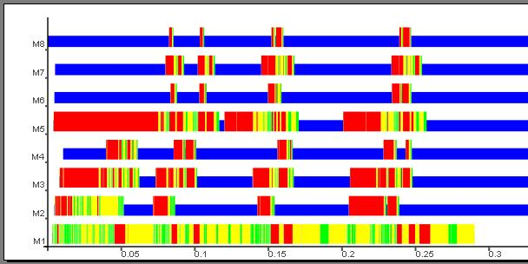
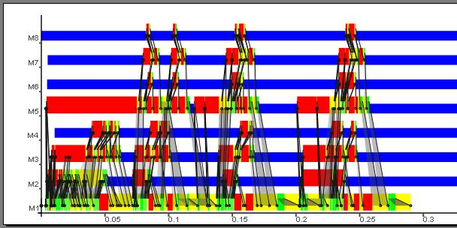
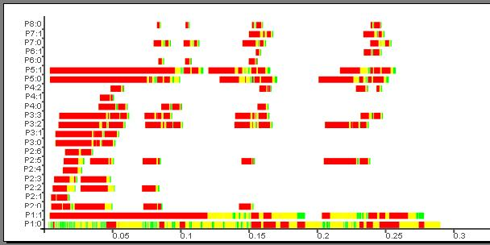
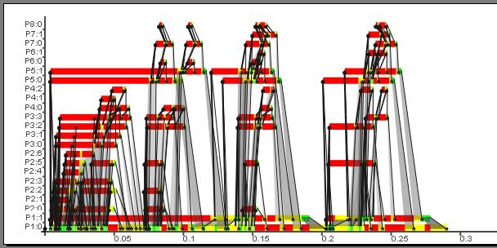
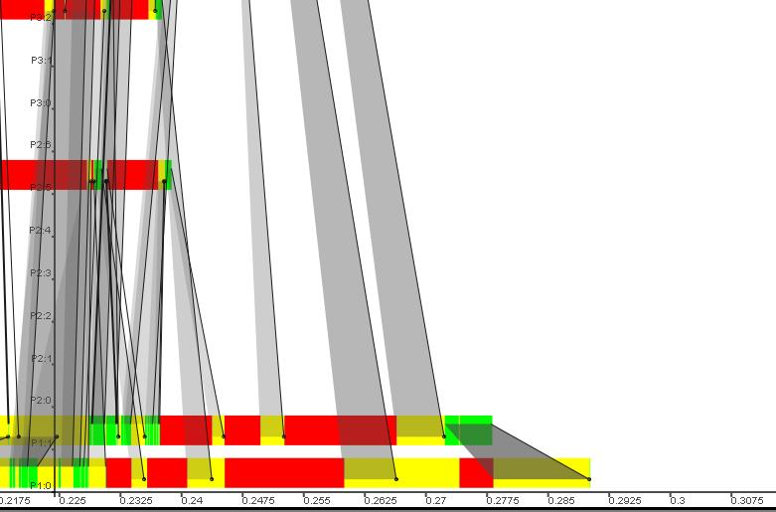
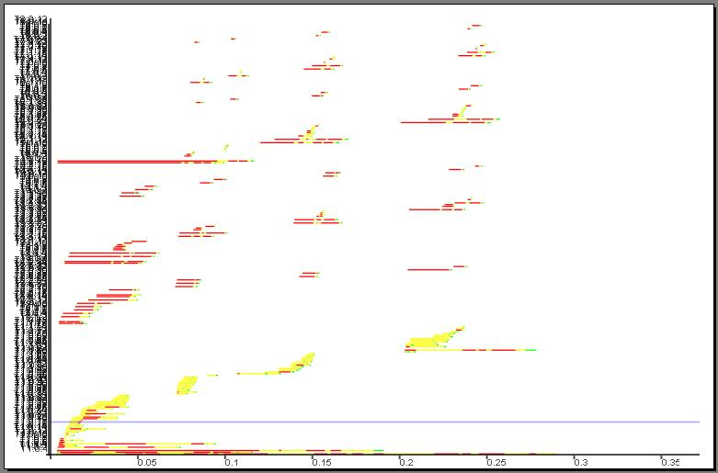
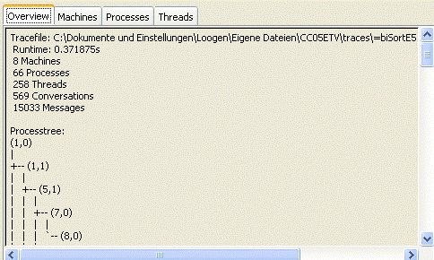
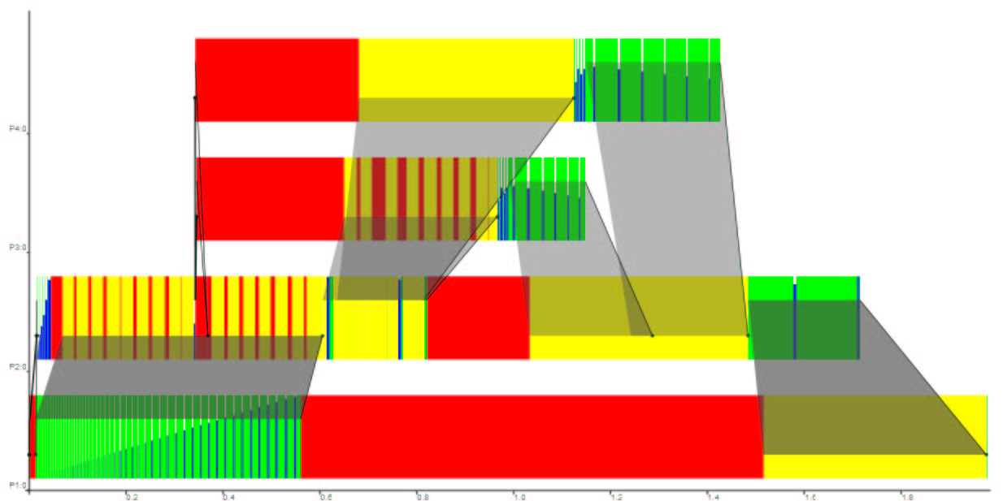
EdenTV
- Diagrams:
Machines (PEs)
Processes
Threads
- Message
Overlays
Machines
Processes
- zooming
- message streams
- additional infos
- ...

Slide 25
EdenTV Demo

Slide 26
Case Study: Merge Sort continued

Slide 27
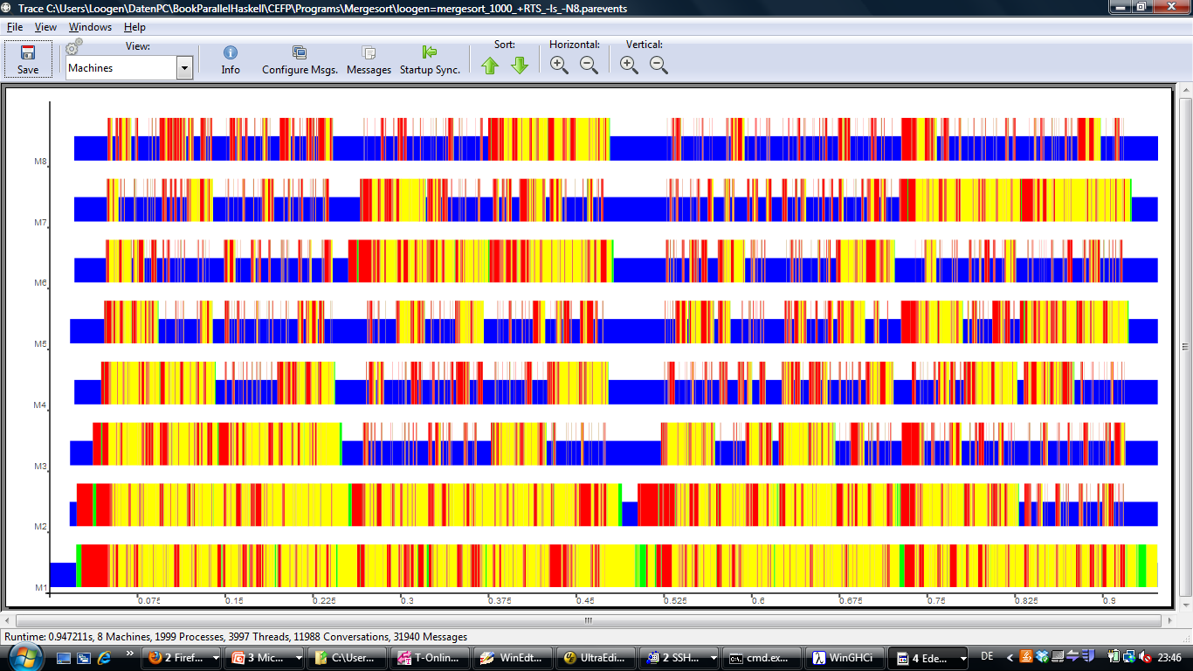
Example: Activity profile of parallel mergesort
Program run, length of input list: 1.000
Observation:
SLOWDOWN
Seq. runtime: 0,0037 s
Par. runtime: 0,9472 s
Reasons:
1999 processes, mostly blocked
31940 messages
delayed process creation
process placement

Slide 28
How can we improve our parallel mergesort?
Here are some rules of thumb.
Adapt the total number of processes to the number of available processor elements (PEs), in Eden: noPe :: Int
Use eager process creation functions spawn or spawnF.
By default, Eden places processes round robin on the available PEs. Try to distribute processes evenly over the PEs.
Avoid element-wise streaming if not necessary, e.g. by putting the list into some „box“ or by chunking it into bigger pieces.
THINK PARALLEL!

Slide 29
Parallel Mergesort revisited
unsorted
sublist 1
sorted
sublist 1
mergesort
unsorted
sublist 2
mergesort
sorted
sublist 2
unsorted
list
sorted
list
unshuffle (noPe-1)
merge many lists
unsorted
sublist noPe-1
sorted
sublist noPe-1
mergesort
unsorted
sublist noPe
sorted
sublist noPe
mergesort

Slide 30
A Simple Parallelisation of map
map :: (a -> b) -> [a] -> [b]
map f xs = [ f x | x <- xs ]
x1
x2
x3
x4
...
f
f
f
f
...
y1
y2
y3
y4
...
parMap :: (Trans a, Trans b) =>
(a -> b) -> [a] -> [b]
parMap f = spawn (repeat (process f))
1 process
per list element

Slide 31
Alternative Parallelisation of mergesort - 1st try
Eden Code:
par_ms :: (Ord a, Show a, Trans a) => [a] -> [a]
par_ms xs
= head $ sms $ parMap mergeSort
(unshuffle (noPe-1) xs))
sms :: (NFData a, Ord a) => [[a]] -> [[a]]
sms [] = []
sms xss@[xs] = xss
sms (xs1:xs2:xss) = sms (sortMerge xs1 xs2) (sms xss)
→ Total number of processes = noPe
→ eagerly created processes
→ round robin placement leads to 1 process per PE
but maybe still too many messages

Slide 32
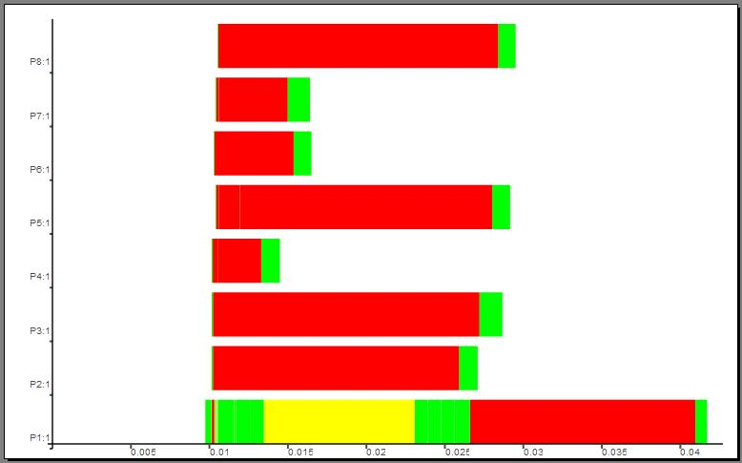
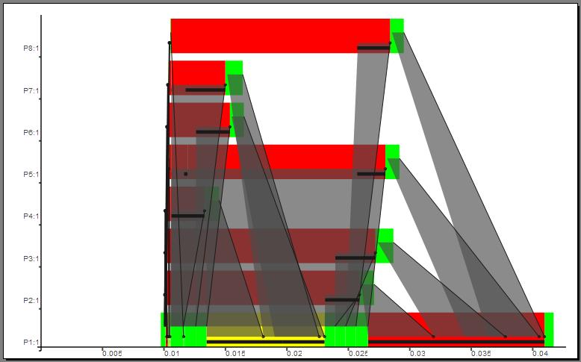
Resulting Activity Profile
(Processes/Machine View)
Previous results for input size 1000
Seq. runtime: 0,0037 s
Par. runtime: 0,9472 s
Input size 1.000
seq. runtime: 0,0037
par. runtime: 0,0427 s
8 Pes, 8 processes, 15 threads
2042 messages
Much better, but still
SLOWDOWN
Reason:
Indeed too many messages

Slide 33
Reducing Communication Costs

Slide 34
Reducing Number of Messages by Chunking Streams
Split a list (stream) into chunks:
chunk :: Int -> [a] -> [[a]]
chunk size [] = []
chunk size xs = ys : chunk size zs
where (ys,zs) = splitAt size xs
Combine with parallel map-implementation of mergesort:
par_ms_c :: (Ord a, Show a, Trans a) =>
Int -> -- chunk size
[a] -> [a]
par_ms_c size xs
= head $ sms $ map concat $
parMap ((chunk size) . mergeSort . concat)
(map (chunk size)(unshuffle (noPe-1) xs)))

Slide 35
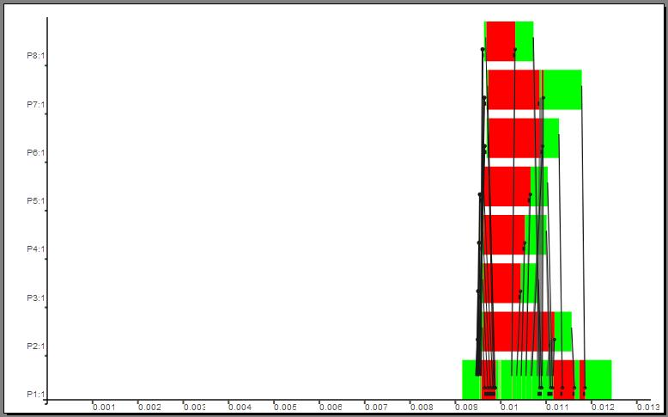
Resulting Activity Profile
(Processes/Machine View)
Previous results for input size 1000
Seq. runtime: 0,0037 s
Par. runtime I: 0,9472 s
Par. runtime II: 0,0427 s
Input size 1.000, chunk size 200
seq. runtime: 0,0037
par. runtime: 0,0133 s
8 Pes, 8 processes, 15 threads
56 messages
Much better, but still
SLOWDOWN
parallel runtime w/o Startup and Finish of parallel system:
0,0125-0,009 = 0,0035
→ increase input size

Slide 36
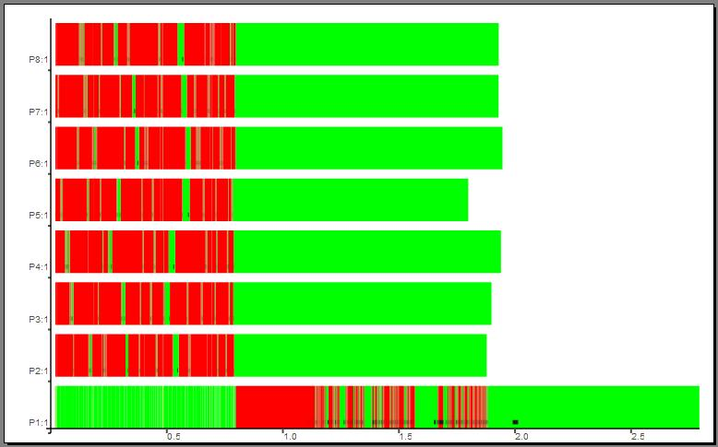
Activity Profile for Input Size 1.000.000
Input size 1.000.000
Chunk size 1000
seq. runtime: 7,287 s
par. runtime: 2,795 s
8 Pes, 8 processes,
15 threads
2044 messages
→ speedup of 2.6
on 8 PE
unshuffle
map mergesort
merge

Slide 37
Further improvement
Idea: Remove input list distribution by local sublist selection:
par_ms_c :: (Ord a, Show a, Trans a) =>
Int -> [a] -> [a]
par_ms_c size xs
= head $ sms $ map concat $
parMap ((chunk size) . mergeSort . concat)
(map (chunk size)(unshuffle (noPe-1) xs)))
→
par_ms :: (Ord a, Show a, Trans a) =>
Int -> [a] -> [a]
par_ms_b size xs
= head $ sms $ map concat $
parMap (\ i -> (chunk size (mergeSort
((unshuffle (noPe-1) xs)!!i))))
[0..noPe-2]

Slide 38
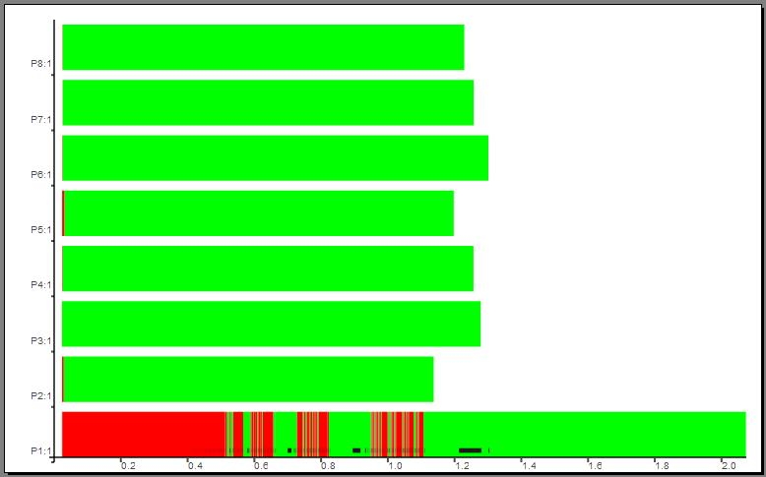
Corresponding Activity Profiles
→
Input size 1.000.000
Chunk size 1000
seq. runtime: 7,287 s
par. runtime: 2,795 s
new par. runtime: 2.074 s
8 Pes, 8 processes,
15 threads
1036 messages
→ speedup of 3.5 on 8 PEs

Slide 39
Parallel map implementations

Slide 40
Parallel map implementations: parMap vs farm
parMap
farm
T
T
T
T
T
T
T
T
...
...
...
...
P
P
P
P
P
P
...
...
PE
PE
PE
PE
farm :: (Trans a, Trans b) =>
([a] -> [[a]]) -> ([[b]] -> [b]) ->
(a -> b) -> [a] -> [b]
farm distribute combine f xs
= combine (parMap (map f)
(distribute xs))
parMap :: (Trans a, Trans b) =>
(a -> b) -> [a] -> [b]
parMap f xs
= spawn (repeat (process f)) xs

Slide 41
Process farms
1 process
per sub-tasklist
with static
task distribution
farm :: (Trans a, Trans b) =>
([a] -> [[a]]) -> -- distribute
([[b]] -> [b]) -> -- combine
(a->b) -> [a] -> [b]
farm distribute combine f xs
= combine . (parMap (map f)) . distribute
Choose e.g.
distribute = unshuffle noPe / combine = shuffle
distribute = splitIntoN noPe / combine = concat
1 process
per PE
with static
task distribution

Slide 42

Example:
Functional Program for Mandelbrot Sets
ul
dimx
Idea: parallel computation of lines
lr
image :: Double -> Complex Double -> Complex Double -> Integer -> String
image threshold ul lr dimx
= header ++ (concat $ map xy2col lines )
where
xy2col ::[Complex Double] -> String
xy2col line = concatMap (rgb.(iter threshold (0.0 :+ 0.0) 0)) line
(dimy, lines) = coord ul lr dimx

Slide 43
Example: Parallel
Functional Program for Mandelbrot Sets
ul
dimx
Idea: parallel computation of lines
lr
image :: Double -> Complex Double -> Complex Double -> Integer -> String
image threshold ul lr dimx
= header ++ (concat $ map xy2col lines)
where
xy2col ::[Complex Double] -> String
xy2col line = concatMap (rgb.(iter threshold (0.0 :+ 0.0) 0)) line
(dimy, lines) = coord ul lr dimx
Replace map by
farm (unshuffle noPe) shuffle
or farmB (splitIntoN noPe) concat

Slide 44
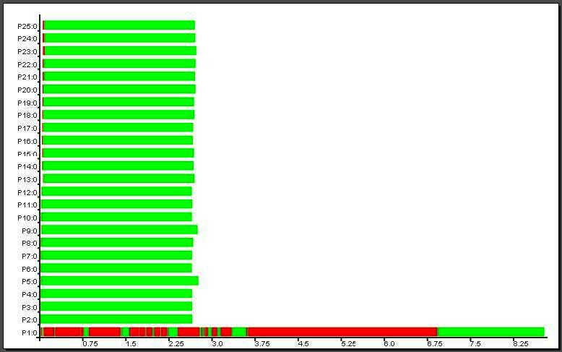
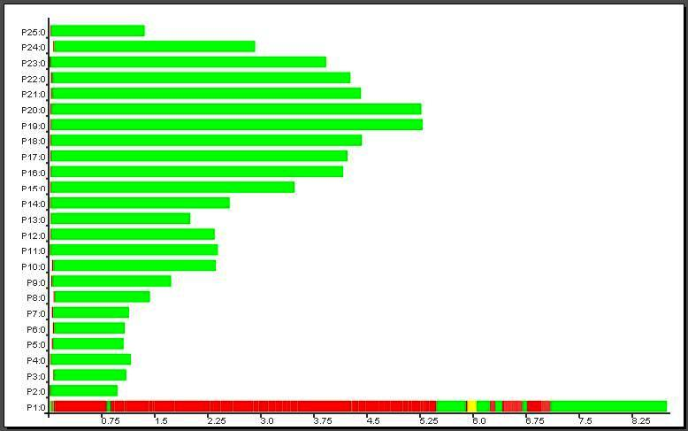
Mandelbrot
Traces
Problem size: 2000 x 2000
Platform: Beowulf cluster
Heriot-Watt-University,
Edinburgh
(32 Intel P4-SMP nodes @ 3 GHz
512MB RAM, Fast Ethernet)
farm (unshuffle noPe) shuffle
round robin static
task distribution
farm (splitIntoN noPe) concat
round robin static
task distribution

Slide 45
Example: Ray Tracing
Camera
2D Image
3D Scene
rayTrace :: Size -> CamPos -> [Object] -> [Impact]
rayTrace size cameraPos scene = findImpacts allRays scene
where allRays = generateRays size cameraPos
findImpacts :: [Ray] -> [Object] -> [Impact]
findImpacts rays objs = map (firstImpact objs) rays

Slide 46
Reducing Communication Costs by Chunking
Combine chunking with parallel map-implementation:
chunkMap :: Int -> (([a] -> [b]) -> ([[a]] -> [[b]]))
-> (a -> b) -> [a] -> [b]
chunkMap size mapscheme f xs
= concat (mapscheme (map f) (chunk size xs))

Slide 47
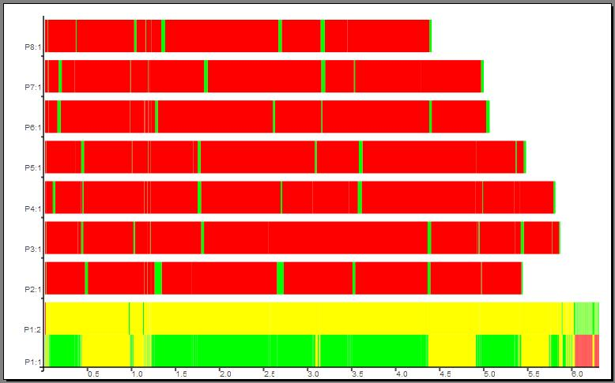
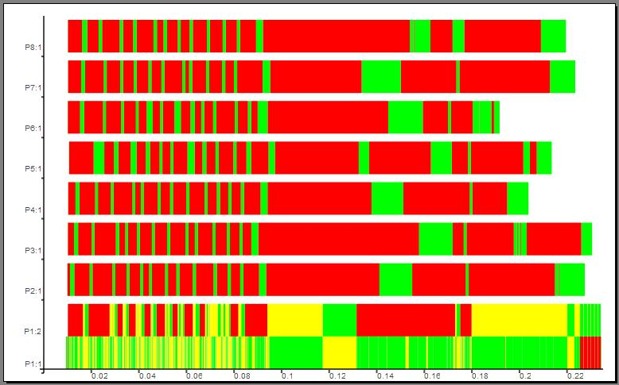
Raytracer Example:
Element-wise Streaming vs Chunking
Input size 250
Runtime: 6,311 s
8 PEs
9 processes
17 threads
48 conversations
125048 messages
Input size 250
Chunk size 500
Runtime: 0,235 s
8 PEs
9 processes
17 threads
48 conversations
548 messages

Slide 48
Communication vs Parameter Passing
Process inputs
- can be communicated: f $# inp
- can be passed as parameter (\ () -> f inp) $# ()
() is dummy process input
graph of process abstraction
#
graph of input expression
will be packed (serialised)
and sent to remote PE
where child process is created
to evaluate this expression
will be evaluated in parent process
by concurrent thread
and then sent to child process

Slide 49
Farm vs Offline Farm
Farm
Offline Farm
T
T
T
T
P
P
...
...
T...T
...
T...T
P
P
PE
PE
...
PE
PE
offlineFarm :: (Trans a, Trans b) =>
([a] -> [[a]]) -> ([[b]] -> [b]) ->
(a -> b) -> [a] -> [b]
offlineFarm distribute combine f xs
= combine $
spawn
(map (rfi (map f)) (distribute xs) )
(repeat ())
rfi :: (a -> b) -> a -> Process () b
rfi h x = process (\ () -> h x)
farm :: (Trans a, Trans b) =>
([a] -> [[a]]) -> ([[b]] -> [b]) ->
(a -> b) -> [a] -> [b]
farm distribute combine f xs
= combine (parMap (map f)
(distribute xs))

Slide 50
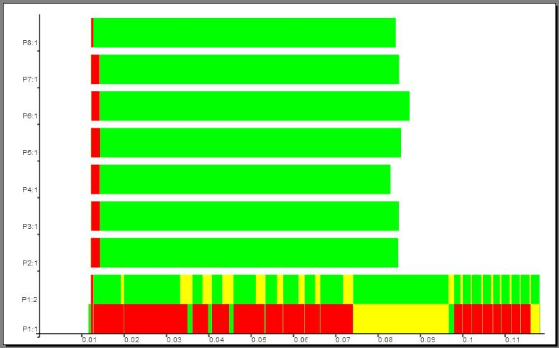
Raytracer Example: Farm vs Offline Farm
Input size 250
Chunk size 500
Runtime: 0,235 s
8 PEs
9 processes
17 threads
48 conversations
548 messages
Input size 250
Chunk size 500
Runtime: 0,119 s
8 PEs
9 processes
17 threads
40 conversations
290 messages

Slide 51
Eden: What we have seen so far
Eden extends Haskell with parallelism
  explicit process definitions and implicit communication
  control of process granularity, distribution of work, and communication topology
  implemented by extending the Glasgow Haskell Compiler (GHC)
  tool EdenTV to analyse parallel program behaviour
rules of thumb for producing efficient parallel programs
  number of processes ~ noPe
  reducing communication
    chunking
    offline processes: parameter passing instead of communication
parallel map implementations
Schemata task decomposition task distribution
parMap regular static: process per task
farm regular static: process per processor
offlineFarm regular static: task selection in processes
workpool irregular dynamic

Slide 52
Overview Eden Lectures
Lectures I & II (Thursday)
  Motivation
  Basic Constructs
  Case Study: Mergesort
  Eden TV –
  The Eden Trace Viewer
  Reducing communication costs
  Parallel map implementations
  Explicit Channel Management
  The Remote Data Concept
  Algorithmic Skeletons
    Nested Workpools
    Divide and Conquer
Lecture III: Lab Session
(Friday Morning)
Lecture IV: Implementation (Friday Afternoon)
  Layered Structure
  Primitive Operations
  The Eden Module
    The Trans class
    The PA monad
    Process Handling
    Remote Data

Slide 53
Many-to-one Communication: merge
Using non-deterministic merge function: merge :: [[a]] -> [a]
Workpool or
Master/Worker Scheme
workpool
merge
worker
0
worker
1
worker
nw-1
masterWorker :: (Trans a, Trans b) => Int -> Int -> (a->b) -> [a] -> [b]
masterWorker nw prefetch f tasks = orderBy fromWs reqs
where fromWs = parMap (map f) toWs
toWs = distribute np tasks reqs
reqs = initReqs ++ newReqs
initReqs = concat (replicate prefetch [0..nw-1])
newReqs = merge [[i | r <- rs] | (i,rs) <- zip [0..nw-1] fromWs]

Slide 54
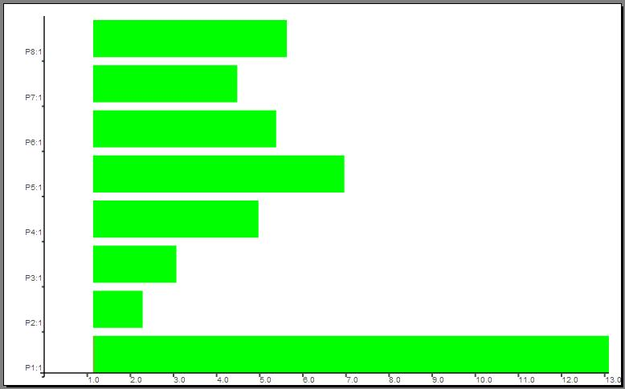
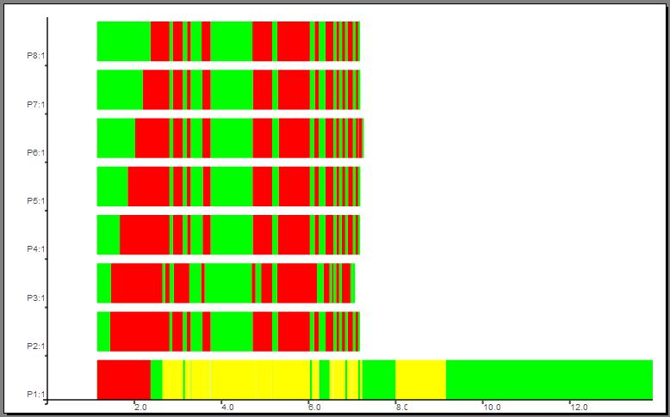
Example: Mandelbrot revisited!
offlineFarm
splitIntoN (noPe-1)
Input size 2000
Runtime: 13,09 s
8 PEs
8 processes
15 threads
35 conversations
1536 messages
masterWorker
prefetch 50
Input size 2000
Runtime: 13,91 s
8 PEs
8 processes
22 threads
42 conversations
3044 messages

Slide 55
Parallel map implementations
static task distribution:
dynamic task distribution:
parMap farm offlineFarm
T
T
T
T
T
T
T
T
...
...
...
...
P
P
P
P
P
P
P
P
T...T
...
T...T
PE
...
PE
PE
...
PE
PE
PE
increasing granularity
workpool
T
T
T
merge
w 0
w 1
w np-1
PE
PE
PE

Slide 56
Explicit Channel Management

Slide 57
Explicit Channel Management in Eden
Example: Definition of a process ring
ring :: (Trans i,Trans o,Trans r) =>
((i,r) -> (o,r)) -> -- ring process fct
[i] -> [o] -- input-output fct
ring f is = os
where
(os, ringOuts)
= unzip [process f # inp |
inp <- lazyzip is ringIns]
ringIns = rightRotate ringOuts
rightRotate xs = last xs : init xs
rightrotate
Problem: only indirect ring connections via parent process

Slide 58
Explicit Channels in Eden
new
parfill
nextChan
prevchan
p
Channel generation
Channel usage
plink ::
(Trans i,Trans o, Trans r) =>
((i,r) -> (o,r)) ->
Process (i,ChanName r)
(o,ChanName r)
plink f = process fun_link
where
fun_link (fromP, nextChan)
= new (\ prevChan prev ->
let
(toP, next)
= f (fromP, prev)
in
parfill nextChan next
(toP, prevChan)
)
new :: Trans a =>
(ChanName a -> a -> b) -> b
parfill :: Trans a =>
ChanName a -> a -> b -> b

Slide 59
Ring Definition
with explicit channels
ring :: (Trans i,Trans o,Trans r) =>
((i,r) -> (o,r)) -> -- ring process fct
[i] -> [o] -- input-output fct
ring f is = os
where
(os, ringOuts)
= unzip [ f # inp |
inp <- lazyzip is ringIns]
ringIns = rightRotate ringOuts
rightRotate xs = last xs : init xs
leftrotate
rightrotate
process
plink
Problem: only indirect ring connections via parent process

Slide 60
Traceprofile Ring
Implicit vs explicit channels
ring with implicit channels -
All communications
go through generator
process (number 1).
Ring with explicit channels –
Ring processes communicate directly.

Slide 61
The Remote Data Concept

Slide 62
The „Remote Data“-Concept
Functions:
  Release local data with release :: a -> RD a
  Fetch released data with fetch :: RD a -> a
Replace
  (process g # (process f # inp))
with
  process (g o fetch) # (process (release o f) # inp)
inp
g
f
inp
g
f

Slide 63
Ring Definition with Remote Data
ring :: (Trans i,Trans o,Trans r) =>
((i,r) -> (o,r)) -> -- ring process fct
[i] -> [o] -- input-output fct
ring f is = os
where
(os, ringOuts)
= unzip [process f_RD # inp |
inp <- lazyzip is ringIns]
f_RD (i, ringIn) = (o, release ringOut)
where (o, ringOut) = f (i, fetch ringIn)
ringIns = rightRotate ringOuts
rightRotate xs = last xs : init xs
type [RD r]

Slide 64
Implementation of Remote Data with dynamic channels
-- remote data
type RD a = ChanName (ChanName a)
-- convert local data into corresponding remote data
release :: Trans a ⇒ a → RD a
release x = new (\ cc c → parfill c x cc)
-- convert remote data into corresponding local data
fetch :: Trans a ⇒ RD a → a
fetch cc = new (\ c x → parfill cc c x)

Slide 65
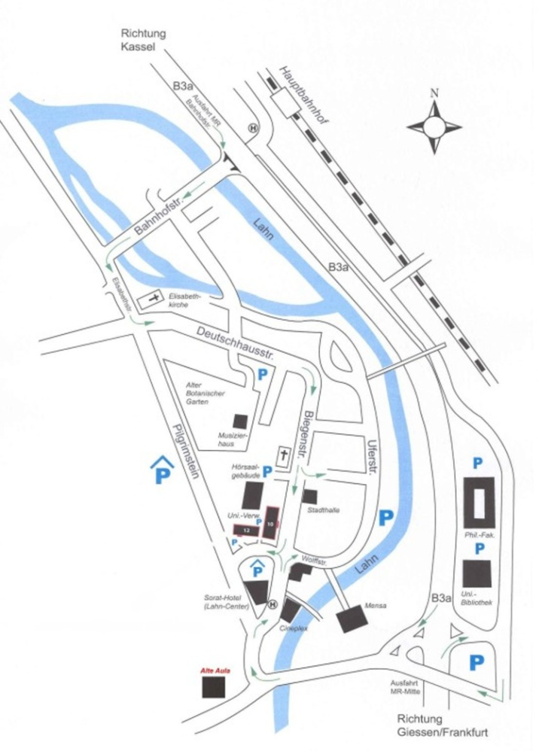
Example: Computing Shortest Paths
Map -> Graph -> Adjacency matrix/
Distance matrix
Main Station
1
1
200
Elisabeth
church
0 200 300 ∞ ∞
0 150 ∞ 400
150 0 50 125
∞ ∞ 50 0 100
∞ 400 125 100 0
2
2
150
300
3
400
3
Town Hall
125
50
4
4
Mensa
Compute the shortest way
from A to B für arbitrary nodes
A and B!
5
5
100
Old University

Slide 66
Warshall‘s algorithm in process ring
Ring
rowi
rowk
Force evaluation of nextrowk by inserting
rnf nextrowk `pseq`
before call of ring_iterate
ring_iterate :: Int -> Int -> Int ->
[Int] -> [[Int]] -> ( [Int], [[Int]])
ring_iterate size k i rowk (rowi:xs)
| i > size = (rowk, []) -- End of iterations
| i == k = (rowR, rowk:restoutput) –- send own row
| otherwise = (rowR, rowi:restoutput) –- update row
where
(rowR, restoutput) = ring_iterate size k (i+1) nextrowk xs
nextrowk | i == k = rowk -- no update, if own row
| otherwise = updaterow rowk rowi (rowk!!(i-1))

Slide 67
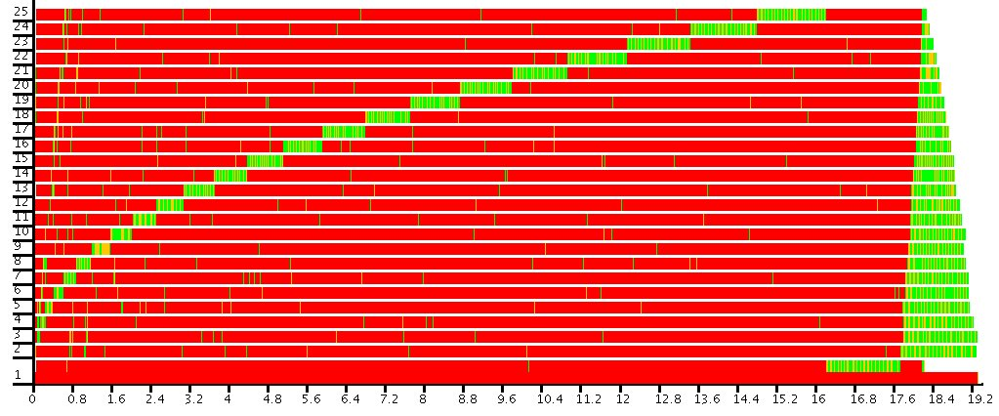
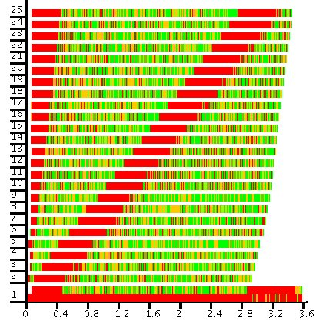
Traces of parallel Warshall
sequential start up phase
With additional demand on
nextrowk
End of
fast
version

Slide 68
(Advanced) Algorithmic Skeletons

Slide 69
Algorithmic Skeletons
patterns of parallel computations
=> in Eden:
parallel higher-order functions
typical patterns:
  parallel maps and master-worker systems:
  parMap, farm, offline_farm, mw (workpoolSorted)
  map-reduce
  topology skeletons: pipeline, ring, torus, grid, trees ...
  divide and conquer
in the following:
  nested master-worker systems
  divide and conquer schemes
See Eden‘s
Skeleton Library

Slide 70
Nesting
Workpools
tasks
results
workpool
merge
sub-wp
sub-wp
sub-wp
worker
1
worker
np-1
worker
0
merge
merge
sub-wp
w0
w1
w{np-1}
sub-wp
sub-wp
sub-wp
sub-wp
w0
w1
w{np-1}
sub-wp
merge
merge
w0
w1
w{np-1}
w0
w1
w{np-1}

Slide 71
Nesting
Workpools
tasks
results
workpool
merge
wpNested :: (Trans a, Trans b) =>
[Int] -> [Int] -> -- branching degrees/prefetches
-- per level
([a] -> [b]) -> -- worker function
[a] -> [b] -- tasks, results
wpNested ns pfs wf = foldr fld wf (zip ns pfs)
where
fld :: (Trans a, Trans b) =>
(Int,Int) -> ([a] -> [b]) -> ([a] -> [b])
fld (n,pf) wf = workpool' n pf wf
sub-wp
sub-wp
sub-wp
worker
1
worker
np-1
worker
0
merge
merge
sub-wp
w0
w1
w{np-1}
sub-wp
sub-wp
sub-wp
sub-wp
w0
w1
w{np-1}
sub-wp
wpnested [4,5] [64,8] yields
merge
merge
w0
w1
w{np-1}
w0
w1
w{np-1}

Slide 72
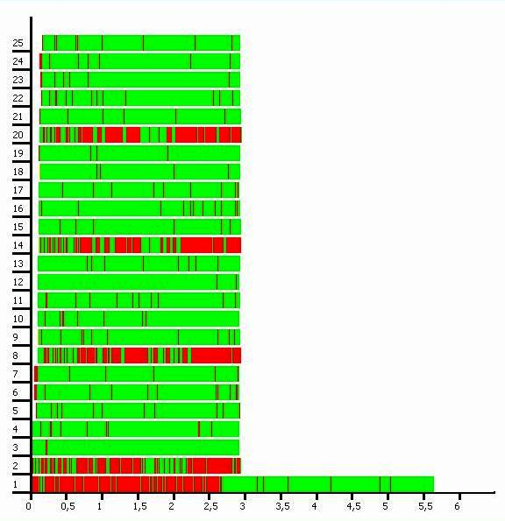
Hierarchical Workpool
1 master
4 submasters
20 workers
faster result collection
via hierarchy
-> better overall runtime
Mandelbrot Trace
Problem size: 2000 x 2000
Platform: Beowulf cluster Heriot-Watt-University, Edinburgh
(32 Intel P4-SMP nodes @ 3 GHz, 512MB RAM, Fast Ethernet)

Slide 73
Experimental Results
Mandelbrot set visualisation
. . . for 5000 5000 pixels, calculated line-wise (5000 tasks)
Platform: Beowulf cluster Heriot-Watt-University
(32 Intel P4-SMP nodes @ 3 GHz, 512MB RAM, Fast Ethernet)
[31] [2,15] [4,7] [6,5] [2,2,4]
logical PEs 32 33 33 37 35

Slide 74
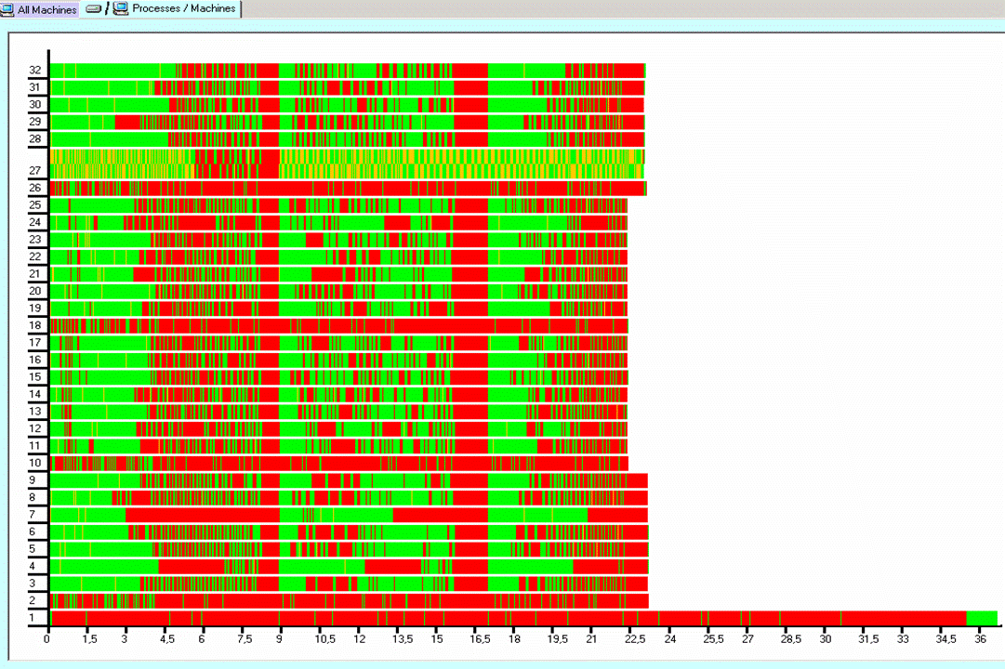
1-Level-Nesting Trace
Garbage
Collection
Prefetch
branching
[4,7]
=> 33 log.PEs
7W
7W
7W
7W
prefetch 40

Slide 75
3-Level-Nesting Trace
branching
[3,2,4]
=> 34 log.PEs
4W
4W
4W
4W
4W
4W
prefetch 60

Slide 76
Divide-and-conquer
dc :: (a->Bool) -> (a->b) -> (a->[a]) -> ([b]->b) -> a->b
dc trivial solve split combine task
= if trivial task then solve task
else combine (map rec_dc (split task))
where rec_dc = dc trivial solve split combine
regular binary scheme
with default placing:
1
1
1
2
1
2
2
1
2
3
1
3
5
3
1
4
3
4
2
4
3
5
1
4
3
6
2
7
5
8
1
4
3
4
2
4
3
5
1
4
3
6
2
7
5
8

Slide 77
Explicit Placement via Ticket List
2,
3, 4, 5, 6, 7, 8
1
1
unshuffle
1
3,
5, 7
2
4,
6, 8
1
2
5
2
6
8
1
7
2
4
1
3
5
3
1
5
3
7
2
6
4
8
1
4
3
6
2
7
5
8
1
5
3
7
2
6
4
8
1
4
3
6
2
7
5
8

Slide 78
Regular DC-Skeleton with Ticket Placement
dcNTickets :: (Trans a, Trans b) =>
Int -> [Int] -> ... -- branch degree / tickets / ...
dcNTickets k [] trivial solve split combine
= dc trivial solve split combine
dcNTickets k tickets trivial solve split combine x
= if trivial x then solve x
else childRes `pseq` rnf myRes `pseq` -- demand control
combine (myRes:childRes ++ localRess )
where childRes = spawnAt childTickets childProcs procIns
childProcs = map (process . rec_dcN) theirTs
rec_dcN ts = dcNTickets k ts trivial solve split combine
-- ticket distribution
(childTickets, restTickets) = splitAt (k-1) tickets
(myTs: theirTs) = unshuffle k restTickets
-- input splitting
(myIn:theirIn) = split x
(procIns, localIns) = splitAt (length childTickets) theirIn
-- local computations
myRes = dcNTickets k myTs trivial solve split combine myIn
localRess = map (dc trivial solve split combine) localIns

Slide 79
Regular DC-Skeleton with Ticket Placement
dcNTickets :: (Trans a, Trans b) =>
Int -> [Int] -> ... -- branch degree / tickets / ...
dcNTickets k [] trivial solve split combine
= dc trivial solve split combine
dcNTickets k tickets trivial solve split combine x
= if trivial x then solve x
else childRes `pseq` rnf myRes `pseq` -- demand control
combine (myRes:childRes ++ localRess )
where childRes = spawnAt childTickets childProcs procIns
childProcs = map (process . rec_dcN) theirTs
rec_dcN ts = dcNTickets k ts trivial solve split combine
-- ticket distribution
(childTickets, restTickets) = splitAt (k-1) tickets
(myTs: theirTs) = unshuffle k restTickets
-- input splitting
(myIn:theirIn) = split x
(procIns, localIns) = splitAt (length childTickets) theirIn
-- local computations
myRes = dcNTickets k myTs trivial solve split combine myIn
localRess = map (dc trivial solve split combine) localIns
arbitrary, but fixed branching degree
flexible, works with
  too few tickets
  double tickets
parallel unfolding controlled by ticket list

Slide 80
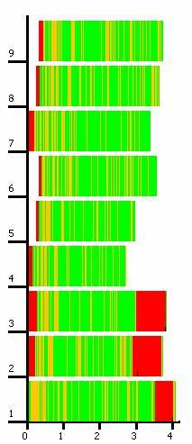
Case Study: Karatsuba
multiplication of large integers
fixed branching degree 3
complexity O(n^{log2 3}),
combine complexity O(n)
Platform: LAN (Fast Ethernet),
7 dual-core linux workstations,
2 GB RAM
input size: 2 integers with 32768 digits each

Slide 81
Divide-and-Conquer Schemes
Distributed expansion
Flat expansion

Slide 82
Divide-and-Conquer Using Master-Worker
divConFlat :: (Trans a,Trans b, Show b, Show a, NFData b) =>
((a->b) -> [a] -> [b])
-> Int -> (a->Bool) -> (a->b) -> (a->[a]) -> ([b]->b) -> a -> b
divConFlat parallelMapSkel depth trivial solve split combine x
= combineTopMaster (\_ -> combine) levels results
where
(tasks,levels) = generateTasks depth trivial split x
results = parallelMapSkel dcSeq tasks
dcSeq = dc trivial solve split combine

Slide 83
Case Study: Parallel FFT
frequency distribution in a signal, decimation in time
4-radix FFT, input size: 4¹⁰ complex numbers
Platform: Beowulf Cluster Edinburgh
Problem:
Communicating
huge data amounts

Slide 84
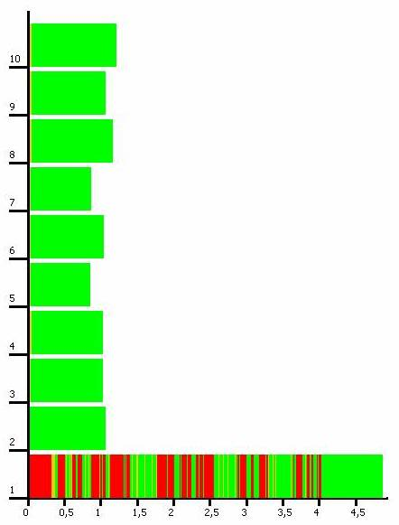
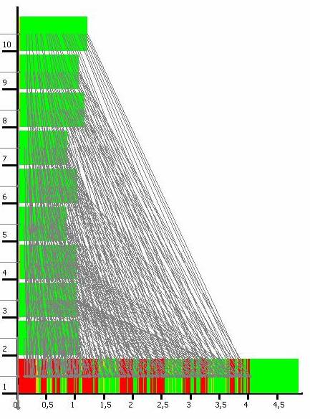
Using Master-Worker-DC

Slide 85
Intermediate Conclusions
Eden enables high-level parallel programming
Use predefined or design own skeletons
Eden‘s skeleton library provides a large collection of sophisticated skeletons:
  parallel maps: parMap, farm, offlineFarm …
  master-worker: flat, hierarchical, distributed …
  divide-and-conquer: ticket placement, via master-worker …
  topological skeletons: ring, torus, all-to-all, parallel transpose …

Slide 86
Eden Lab Session
Download the exercise sheet from
http://www.mathematik.uni-marburg.de/~eden/?content=cefp
Choose one of the three assignments and download the corresponding sequential program:
sumEuler.hs (easy) - juliaSets.hs (medium) - gentleman.hs (advanced)
Download the sample mpihosts file and modify it to randomly chosen lab computers nylxy with xy chosen from 01 up to 64
Call edenenv to set up the environment for Eden
Compile Eden programs with
ghc –parmpi --make –O2 –eventlog myprogram.hs
Run compiled programs with
myprogram <parameters> +RTS –ls -Nx -RTS with x=noPe
View activity profile (trace file) with
edentv myprogram_..._-N…_-RTS.parevents

Slide 87
Eden‘s Implementation

Slide 88
Glasgow Haskell Compiler
& Eden Extensions
Haskell Eden
core syntax
simplify
Lex/Yacc parser
core to STG
prefix form
simplify
STG
Front end
reader
code generation
(parallel Eden
runtime system)
abs. syntax
renamer
abs. syntax
abstract C
type checker
Message
Passing
Library
MPI or PVM
flattening
abs. syntax
C
desugarer
C compiler

Slide 89
Eden‘s parallel runtime system (PRTS)
Modification of GUM, the PRTS of GpH (Glasgow Parallel Haskell):
Recycled
  Thread management: heap objects, thread scheduler
  Memory management: local garbage collection
  Communication: graph packing and unpacking routines
Newly developed
  Process management: runtime tables, generation and termination
  Channel management: channel representation, connection, etc.
Simplifications
  no „virtual shared memory“ (global address space) necessary
  no globalisation of unevaluated data
  no global garbage collection of data

Slide 90
DREAM: DistRibuted Eden Abstract Machine
abstract view of Eden‘s parallel runtime system
abstract view of process:
HEAP
BH
in-
ports
BH
out-
ports
.
.
.
.
.
.
.
.
.
BH
Thread represented by TSO (thread state object) in the heap
BH
black hole closure, on access threads are suspended until this closure is overwritten

Slide 91
Garbage Collection and Termination
no global address space
local heap
inports/outports
no need for global garbage collection
local garbage collection
outports as additional roots
  inports can be recognised as garbage
close
BH
BH
in-
ports
BH
BH
out-
ports
.
.
.
.
.
.
.
.
.
.
.
.
BH
BH

Slide 92
Implementation of Eden
Parallel programming on a high level of abstraction
  explicit process definitions
  implicit communication
Automatic process and channel management
  Distributed graph reduction
  Management of processes and their interconnecting channels
  Message passing
Eden
?
Eden
Runtime System (RTS)

Slide 93
Implementation of Eden
Parallel programming on a high level of abstraction
  explicit process definitions
  implicit communication
Automatic process and channel management
  Distributed graph reduction
  Management of processes and their interconnecting channels
  Message passing
Eden
Eden Module
Eden
Runtime System (RTS)

Slide 94
Layer Structure
Eden programs
Skeleton Library
Eden Module
Primitive Operations
Parallel GHC Runtime System

Slide 95
Parprim – The Interface to the Parallel RTS
Primitive operations provide the basic functionality :
channel administration
    primitive channels (= inports) data ChanName' a = Chan Int# Int# Int#
    create communication channel(s) createC :: IO ( ChanName' a, a )
    connect communication channel connectToPort :: ChanName' a -> IO ()
communication
    send data sendData :: Mode -> a -> IO ()
    modi data Mode = Connect | Stream | Data |
    Instantiate Int
thread creation fork :: IO () -> IO ()
general noPE, selfPE :: Int
PE Process Inport

Slide 96
The Eden Module
Type class Trans
transmissible data types
overloaded communication functions
for lists (-> streams): write :: a -> IO ()
and tuples (-> concurrency): createComm :: IO (ChanName a, a)
process :: (Trans a, Trans b) => (a -> b) -> Process a b
( # ) :: (Trans a, Trans b) => Process a b -> a -> b
spawn :: (Trans a, Trans b) => [Process a b] -> [a]->[b]
explicit definitions
of process, ( # ) and Process
as well as spawn
explicit channels
newtype ChanName a
= Comm (a -> IO ())

Slide 97
Type class Trans
class NFData a => Trans a where
write :: a -> IO ( )
write x = rnf x `pseq` sendData Data x
createComm :: (ChanName a, a)
createComm = do (cx, x) <- createC
return (Comm (sendVia cx), x)
sendVia :: ChanName’ a -> a -> IO ()
sendVia ch d = do connectToPort ch
write d

Slide 98
Tuple transmission by concurrent threads
instance (Trans a, Trans b) => Trans (a,b) where
createComm = do (cx,x) <- createC
(cy,y) <- createC
return (Comm (write2 (cx,cy)),
(x,y))
write2 :: (Trans a, Trans b) =>
(ChanName' a, ChanName' b) -> (a,b) -> IO ()
write2 (c1,c2) (x1,x2) = do fork (sendVia c1 x1)
sendVia c2 x2

Slide 99
Stream Transmission of Lists
instance Trans a => Trans [a] where
write l@[] = sendData Data l
write (x:xs) = do (rnf x `pseq` sendData Stream x)
write xs

Slide 100
The PA Monad
Improving control over parallel activities:
newtype PA a = PA { fromPA :: IO a }
instance Monad PA where
return b = PA $ return b
(PA ioX) >>= f = PA $ do x <- ioX
fromPA $ f x
runPA :: PA a -> a
runPA = unsafeperformIO . fromPA

Slide 101
Remote Process Creation
data (Trans a, Trans b) =>
Process a b
= Proc (ChanName b -> ChanName‘(ChanName a) -> IO ( ) )
process :: (a -> b) -> Process a b
process f = Proc f_remote
where f_remote (Comm sendResult) inCC
= do (sendInput, invals) = createComm
connectToPort inCC
sendData Data sendInput
sendResult (f invals)
channel for
returning input channel handle(s)
output channel(s)
Process Output

Slide 102
Process Instantiation
( # ) :: (Trans a, Trans b) => Process a b -> a -> b
pabs # inps
= unsafePerformIO $ instantiateAt 0 pabs inps
instantiateAt :: (Trans a, Trans b) =>
Int -> Process a b -> a -> IO b
instantiateAt pe (Proc f_remote) inps
= do (sendresult, result) <- createComm
(inCC, Comm sendInput) <- createC
sendData (Instantiate pe)
(f_remote sendresult inCC)
fork (sendInput inps)
return result
output channel(s)
channel for
returning input channel handle(s)

Slide 103
PE 1
PE 2
System
Parent Process
Child Process
create input channels (inports)
for child process‘ results
create input channels
send input channels
to parent process
create input channels
for receiving child process‘
input channels
create outports and fork threads
for evaluating output components
send instantiate message
with created input channels
H
E
A
P
evaluate output component n
evaluate output component 2
evaluate output component 1
create outports and fork threads
for sending inputs to child process
send results to parent
and terminate thread
send results to parent
and terminate thread
send results to parent
and terminate thread
H
E
A
P
continue evaluation
evaluate input components to NF
evaluate input components to NF
evaluate input component n to NF
terminate process and
close inports
send results to child
and terminate thread
send results to child
and terminate thread
send results to child
and terminate thread

Slide 104
Conclusions of Lecture 3
Layered implementation of Eden
  More flexibility
  Complexity hidden
  Better Maintainability
  Lean interface to GHC RTS
Eden programs
Skeleton Library
Eden Module
Primitive Operations
Parallel GHC Runtime System

Slide 105
Conclusions
www.informatik.uni-marburg.de/~eden
Eden = Haskell + Coordination
Explicit Process Definitions
Implicit Communication (Message Transfer)
Explicit Channel Management
-> arbitrary process topologies
Nondeterministic Merge
-> master worker systems with dynamic load balancing
Remote Data
-> pass data directly from producer to consumer processes
Programming Methodology: Use Algorithmic Skeletons
EdenTV to analyse parallel program behaviour
Available on several platforms

Slide 106
More on Eden
PhD Workshop tomorrow 16:40-17:00
Bernhard Pickenbrock:
Development of a multi-core implementation of Eden

